Slide 1
Impulse and Momentum in a Particle
Dr. Jacob Moore
Associate Professor of Engineering
Penn State Mont Alto

Slide 2
Impulse and Momentum
So far...
We have used kinematics to relate position, velocity, and acceleration.
And we have used the force mass and acceleration branch of kinetics, to relate forces to the motion of bodies.
We have used work and energy methods (a second branch of kinetics), as an alternative way to relate forces and motion.
Now we will use the impulse momentum method (a third branch of kinetics), as an alternative to both the force, mass and acceleration method and the work and energy method.

Slide 3
Impulse and Momentum
Impulse and momentum are related in that the net impulse exerted on a body over some time will be equal to the change in that body’s momentum.
$$\overset{⃑}{J}=m\overset{⃑}{v_{f}}−m\overset{⃑}{v_{i}}$$
Initial Momentum
Impulse
Final Momentum

Slide 4
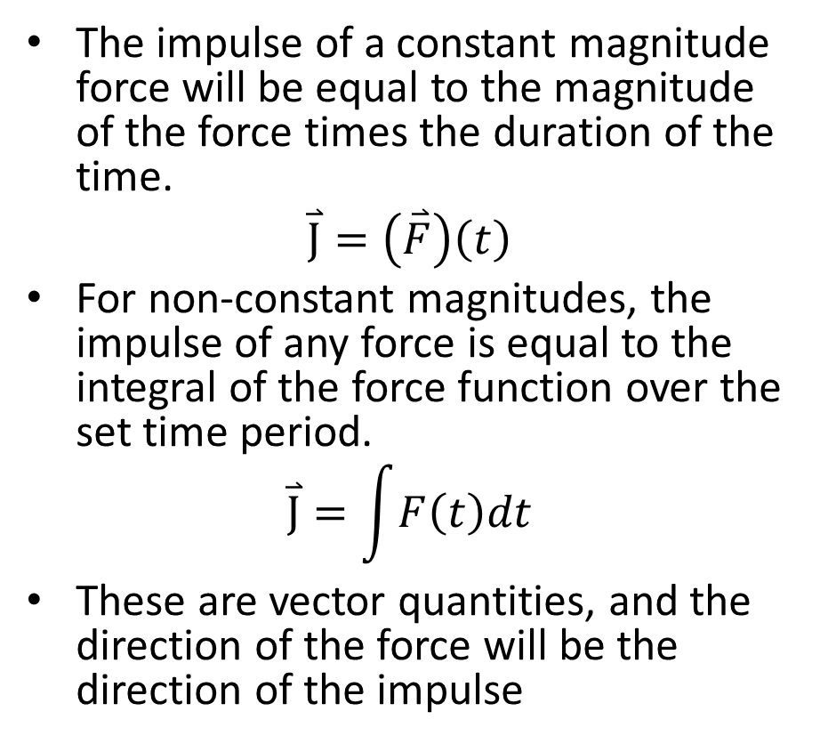
Impulse
The impulse of a constant magnitude force will be equal to the magnitude of the force times the duration of the time.
$$\overset{⃑}{J}=\left(\overset{⃑}{F}\right)\left(t\right)$$
For non-constant magnitudes, the impulse of any force is equal to the integral of the force function over the set time period.
$$\overset{⃑}{J}=\int{F\left(t\right)dt}$$
These are vector quantities, and the direction of the force will be the direction of the impulse
Force
(kN)
Time
(s)

Slide 5
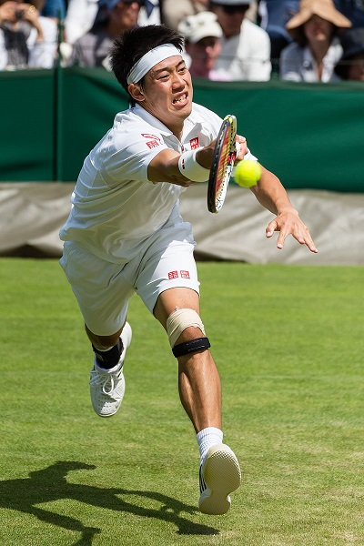
Impulsive Forces
We will often use the impulse momentum equations in instances where we have impulsive forces.
These are forces that have a very large magnitude but are exerted for a very short period of time.
Impact or collision forces are usually impulsive forces.
For forces that only last milliseconds, it can be very difficult to directly measure them.
The impulse-momentum equations can deal with the uncertainty of these forces, as we will see later.
Photo by DAVID ILIFF. License: CC BY-SA 3.0

Slide 6
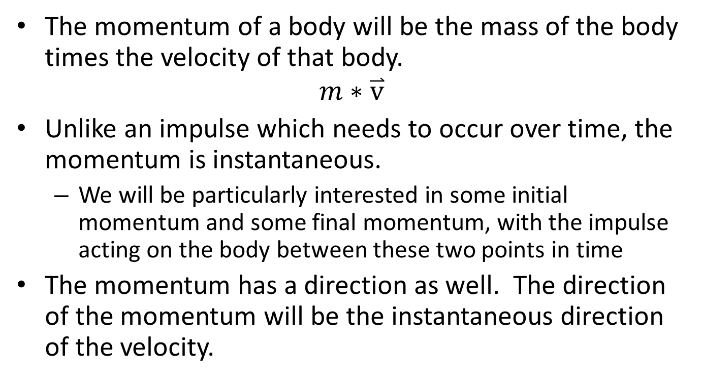
Momentum
The momentum of a body will be the mass of the body times the velocity of that body.
$$m∗\overset{⃑}{v}$$
Unlike an impulse which needs to occur over time, the momentum is instantaneous.
We will be particularly interested in some initial momentum and some final momentum, with the impulse acting on the body between these two points in time
The momentum has a direction as well. The direction of the momentum will be the instantaneous direction of the velocity.

Slide 7
Impulse and Momentum in Two Dimensions
Remember that both Impulse and Momentum are vector quantities...
$$\overset{⃑}{J}=m\overset{⃑}{v_{f}}−m\overset{⃑}{v_{i}}$$
This means that for two dimensional problems we can rewrite the vector equation as two scalar equations.
$$J_{x}=mv_{fx}−mv_{ix}$$
$$J_{y}=mv_{fy}−mv_{iy}$$

Slide 8
Thanks for Watching
See other engineering mechanics videos and access the full tool at…

